Slide 1
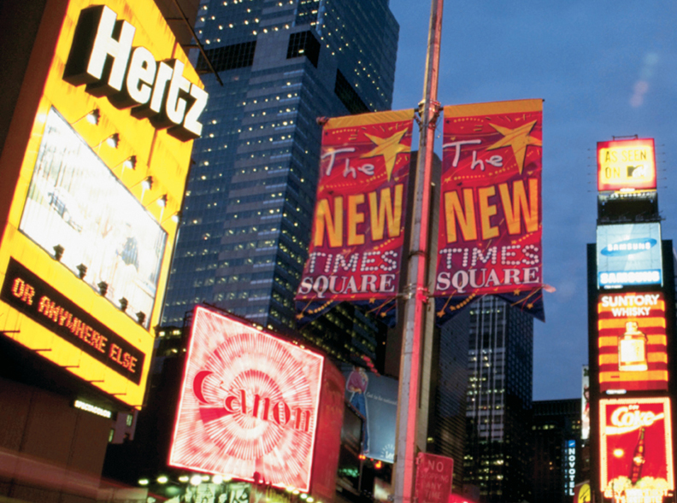
Chapter 17 Promotional Concepts and Strategies
Section 17.1 Promotion and Promotional Mix
Section 17.2 Types of Promotion

Slide 2
Sales Promotion
Sales promotions are incentives that encourage customers (consumers or B2B) to buy products or services and are short term tactics
They can be used to:
Encourage customers to try a new product
Build awareness and reward loyalty
Increase purchases by current customers

Slide 3
Two Type of Sales Promotions
Trade Promotions – Directed at retailers (B2B) Trade promotions are sales promotion activities designed to get support for a product from Wholesalers and retailers
Consumer Promotions – Directed at Consumers
Consumer promotions: are sales strategies that encourage consumers to buy a product or service
Do you think more money is spent promoting to businesses or consumers?
Businesses

Slide 4
Assignment: Type of Promotion Presentation

Slide 5
1 Trade Promotions
Trade promotions are sales promotion activities designed to get support for a product from Wholesalers and retailers
Five Types of Trade Promotions:
Promotional Allowances
Cooperative Advertising
Slotting Allowances
Sales Force Promotions
Trade Shows and Conventions
Marketing Essentials Chapter 17, Section 17.2

Slide 6
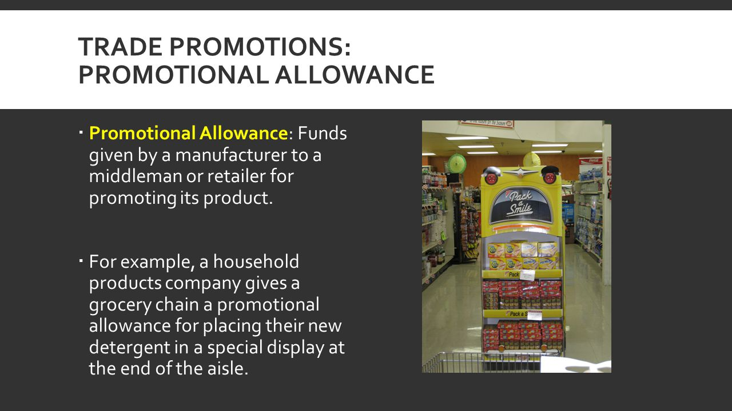
1. Promotional Allowances
Promotional allowances – funds given by a manufacturer as an incentive to retailers for promoting the product
Large discount as an incentive to place a product on special display in high traffic areas (i.e. the end of the isle)
Marketing Essentials Chapter 17, Section 17.2

Slide 7
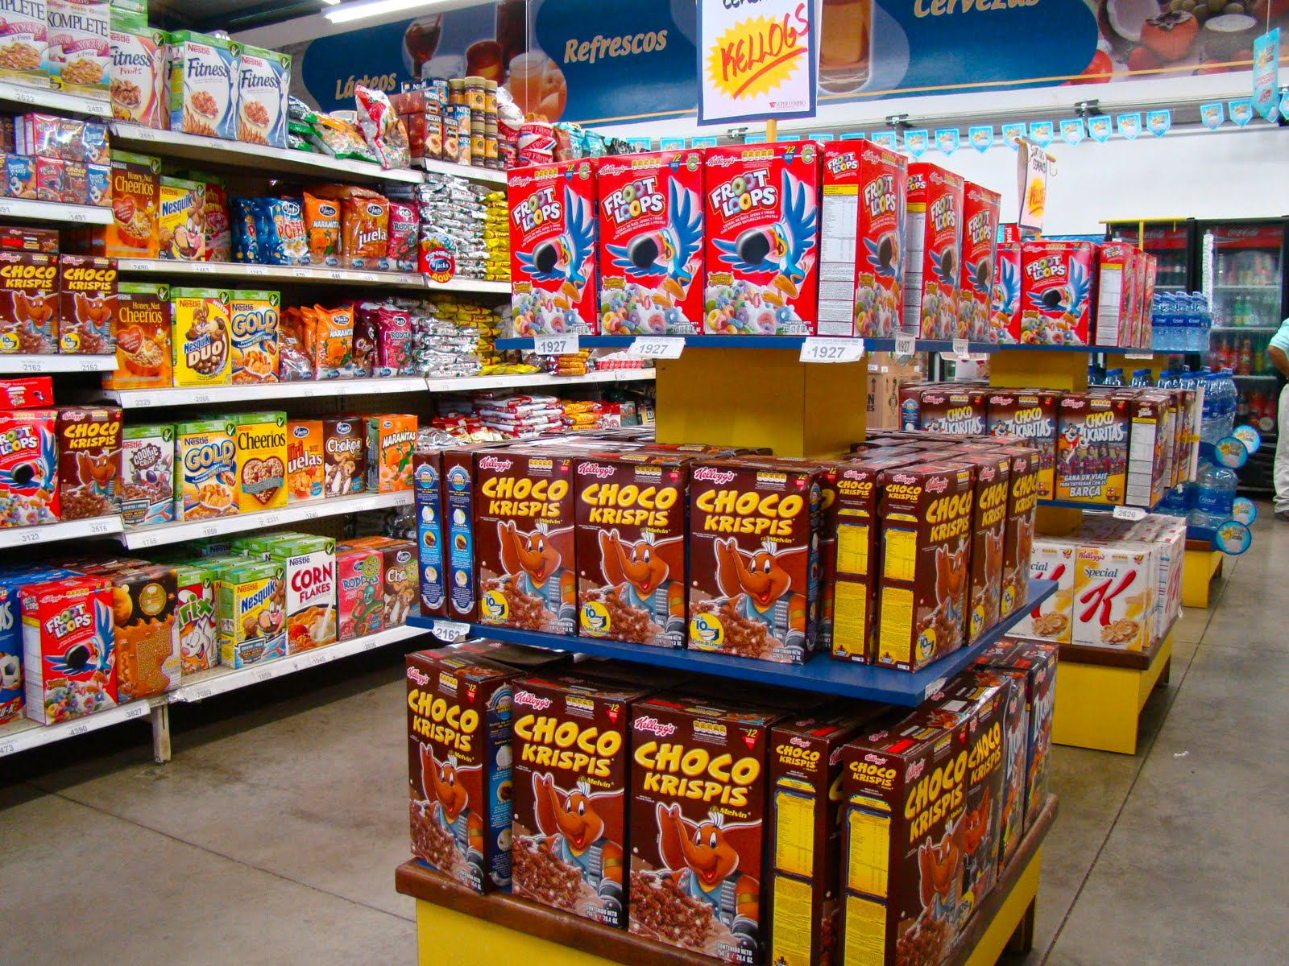
Promotional Allowance – cash paid for a high traffic area

Slide 8
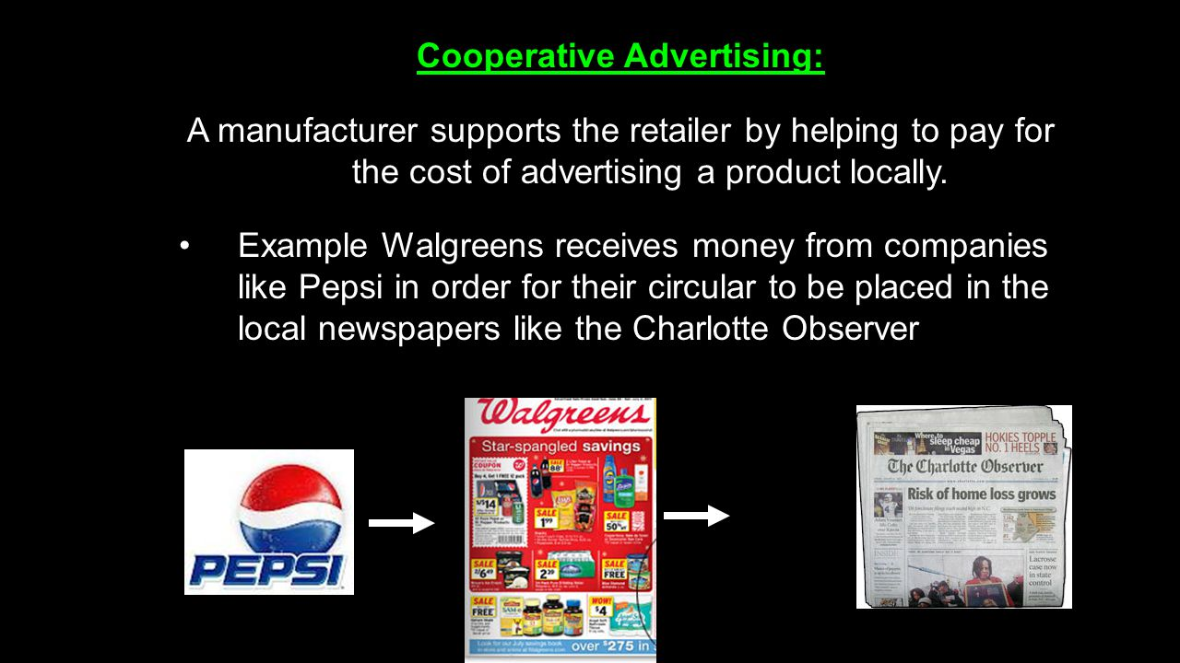
2. Cooperative advertising is when multiple brands collaborate together to form a mutually beneficial promotion.
advertising where a retailer or a wholesaler share the costs of an advertising campaign with the manufacturer of the product being advertised with local business

Slide 9
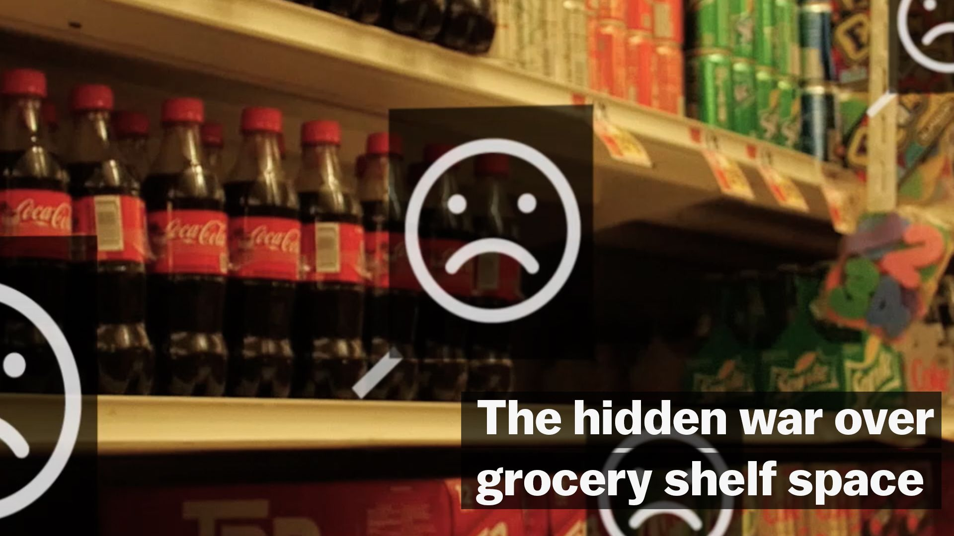
3. Slotting allowances – manufactures pay a cash amount to a retailers for placing a new product on the shelves – Battle of the Brands, pay to stay fees
The fee varies greatly: For a new product, the initial slotting fee may be approximately $25,000 but may be as high as $250,000 in high-demand markets.
Many grocers earn more profit from agreeing to carry products than they do actually selling it.

Slide 10
4: Sales Force Promotions awards given to dealers/employee who meet or exceed a set sales quota
Can be for a specific period of time on a specific product
Video

Slide 11
5: Trade shows and conventions An exhibition for companies to showcase and demonstrate their new products and services
Provide businesses with opportunities to:
Introduce new products
Encourage increased sales of existing products
Meet customers and partners
Vegas Consumer Electronics Show = 190,000 businesses

Slide 12
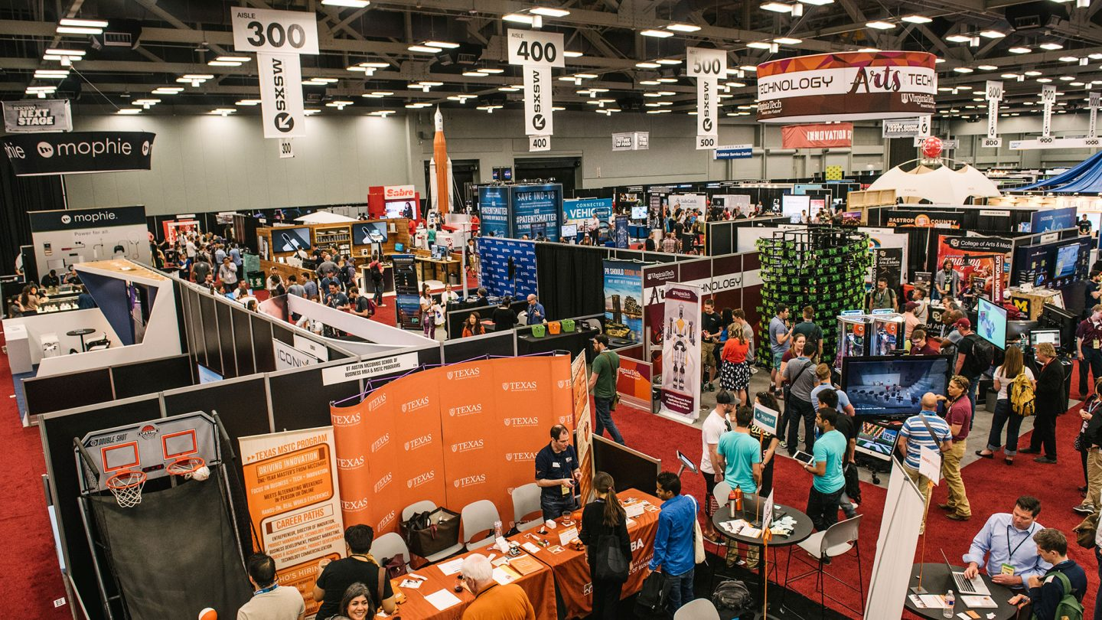

Slide 13
2. Consumer Promotions
Consumer promotions are sales strategies that encourage customers and prospects to buy a product or service
Purpose of Consumer Promotions:
Promotions are intended to boost sales.
Marketing Essentials Chapter 17, Section 17.2

Slide 14
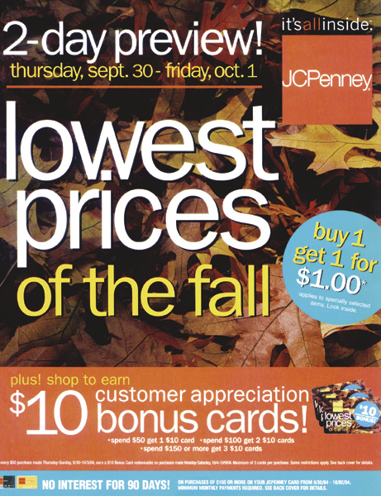
Types of Consumer Promotions
Coupons
Premiums
Deals
Incentives
Product samples
Sponsorship
Promotional Tie-ins
Product Placement
Loyalty Programs
Point-of-Purchase Displays

Slide 15
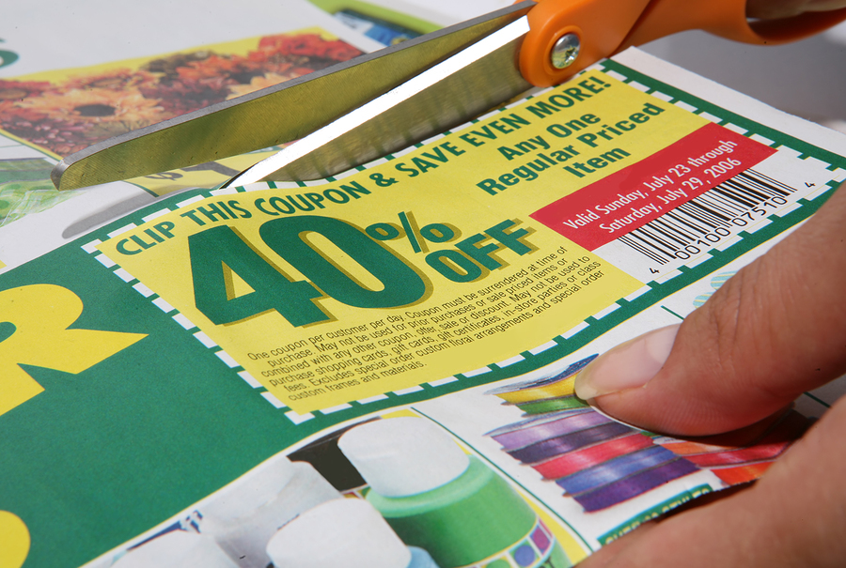
Consumer Promotions
Coupons are certificates that entitle customers to cash discounts on goods or services
Purpose:
introduce new products
enhance sales of existing products
encourage retailers to stock and advertised a specific product

Slide 16
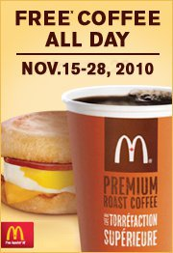
Consumer Promotions
Premiums are low-cost items given to consumers at a discount or for free
They also offer consumers an added-value gift in exchange for their purchase
Factory Packs: free gifts in product packages (cereal boxes)
Traffic builders: free pens, key chains etc. given for visiting a new store or special event
Coupon Plans: exchange labels off product for a free gift (three labels off soup for a cookbook)

Slide 17
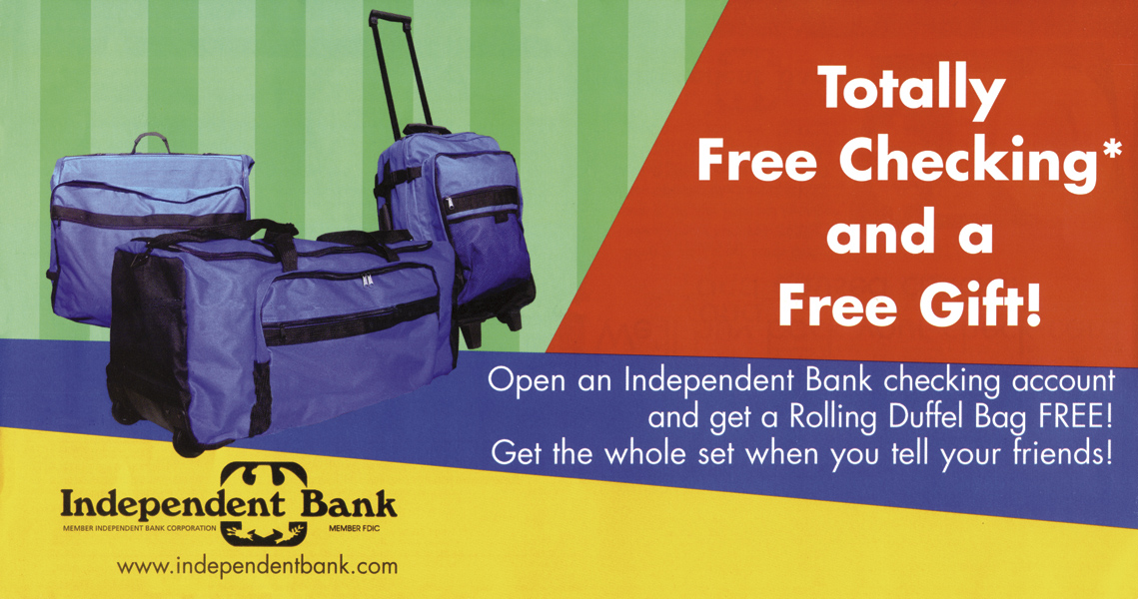
Consumer Premiums
Giveaways encourage customers to visit a store or service provider.

Slide 18
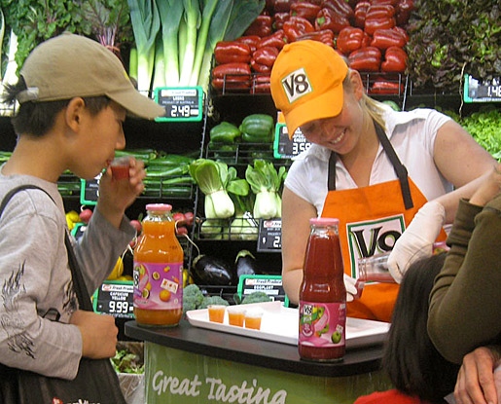
Product Samples
A sample of a consumer product that is given to the consumer free of cost so that he or she may try a product before committing to buy it.
35% will buy the sampled product
58% will buy again
59% more likely to tell others

Slide 19
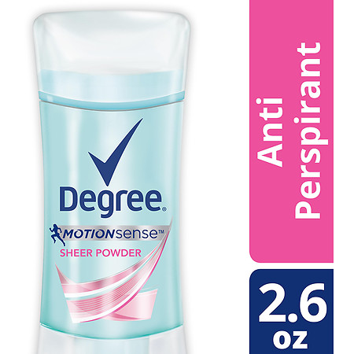
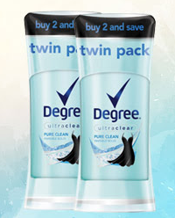
Deals or price packs or bonus packs offer short term price reductions marked directly on the package
Two products bound together for the price of one (package of two deodorants)
$2.79
$4.70 or $2.35 each

Slide 20
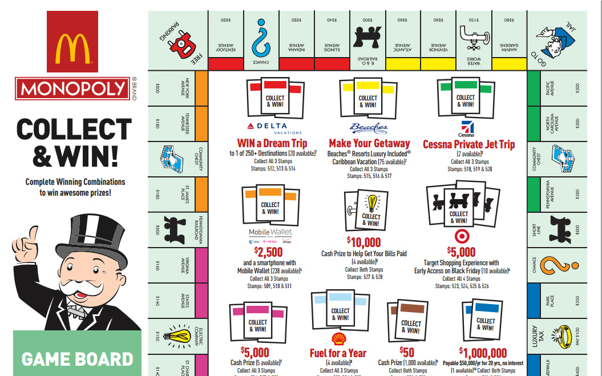
Incentives are higher-priced products earned and given away through: Contests, Sweepstakes or rebates

Slide 21
Consumer Promotions
Sponsorship: a sponsoring company pays a fee for the right to promote itself and its products at or on a set location, such as:
A physical site: ex: a stadium
An event – ex: concert, or sporting event
A group – ex: car racing team
A person: ex: a golfer, a basketball player
Marketing Essentials Chapter 17, Section 17.2

Slide 22
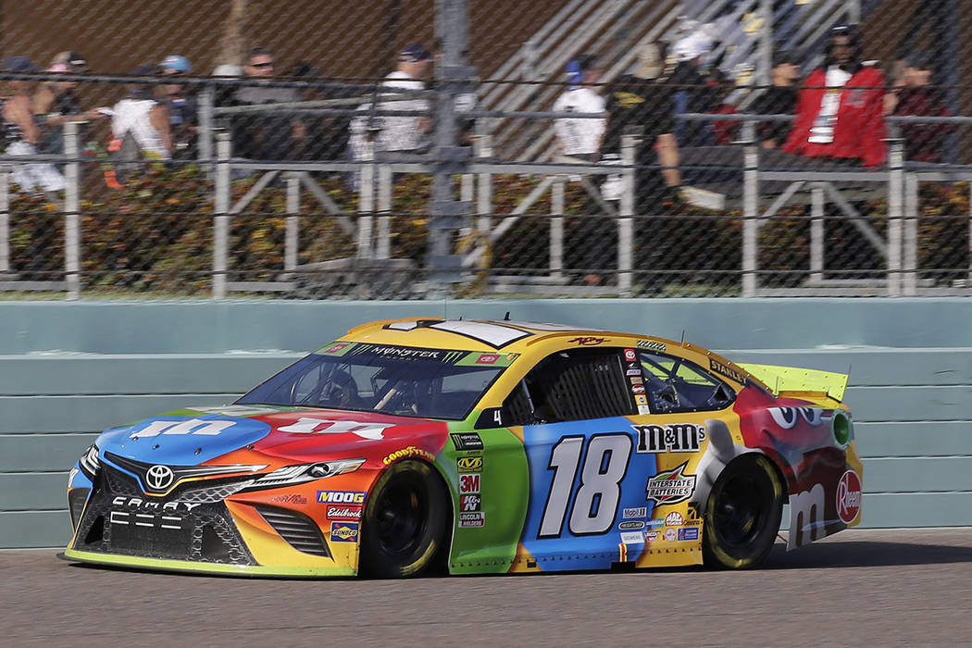

Slide 23
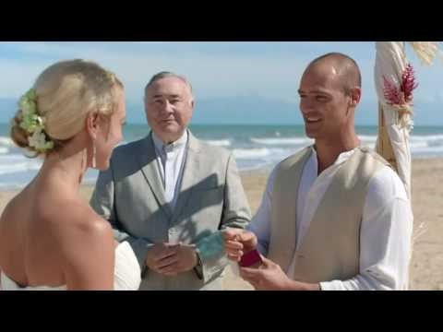
Consumer Promotions
Promotional tie-ins: promotional events where two or more retailers/manufactures team together to promote their products
Marketing Essentials Chapter 17, Section 17.2

Slide 24
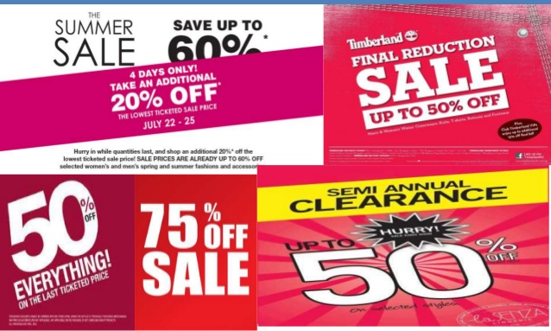
Discounts
Discounts: a deduction from the usual cost of something

Slide 25
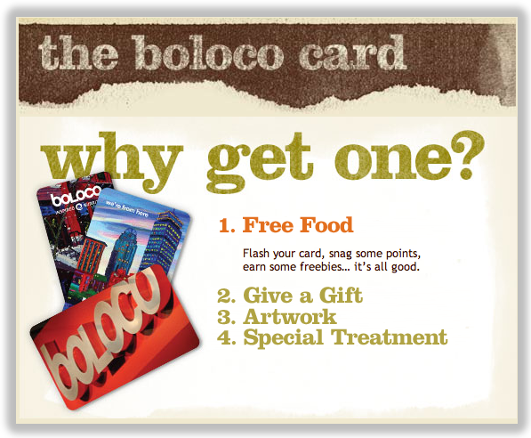
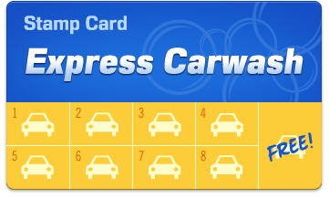
Consumer Promotions
Loyalty marketing programs, also called frequent buyer programs, reward customers for patronizing a company
Punch cards, frequent flyer, free hotel stays

Slide 26
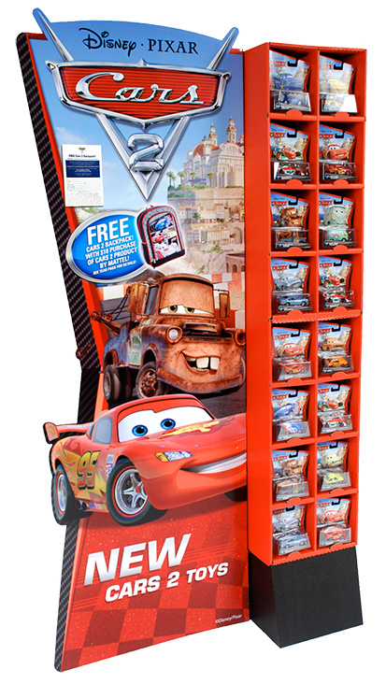
Consumer Promotions
Point-of-purchase displays are manufacturer designed displays for their specific product
usually placed in high-traffic areas and promote impulse purchases
Marketing Essentials Chapter 17, Section 17.2

Slide 27
Consumer Promotions
Point-of-purchase displays are manufacturer designed displays for their specific product in high traffic areas
usually placed in high-traffic areas and promote impulse purchases
Marketing Essentials Chapter 17, Section 17.2

Slide 28
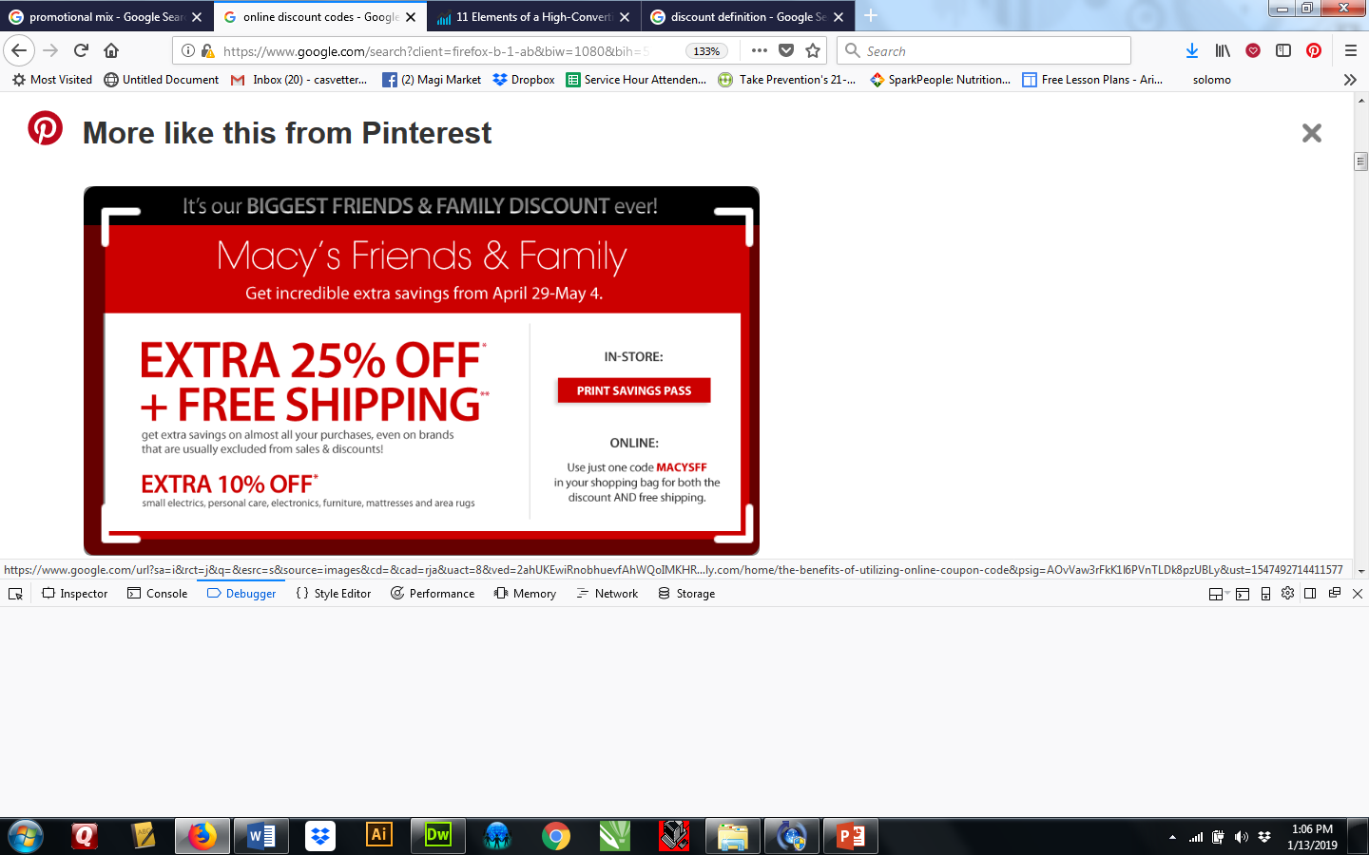
Online Discount Codes - In e-commerce and online shopping, a computer-generated code, that consumers can enter into a promotional box on a site's shopping cart (or checkout page) to obtain a discount on their purchase.

Slide 29
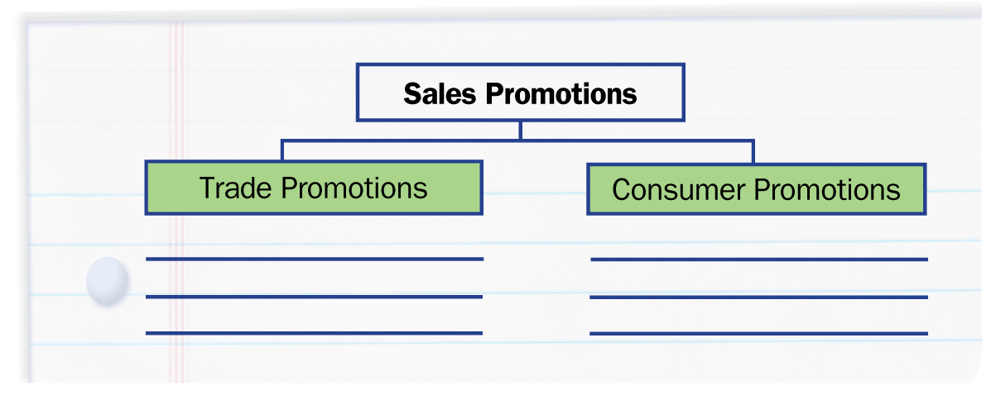
Types of Promotion
Graphic Organizer
Draw a two-column chart like this one to list examples for each type of sales promotion.
Marketing Essentials Chapter 17, Section 17.2

Slide 30
Consumer Promotions
Product Placement: using a brand-name product in a movie, television show, or sporting event
Marketing Essentials Chapter 17, Section 17.2

Slide 31
